Slide 1
MGS 425 (S2S)
Management of it projects
Week 4 – February 22nd

Slide 2
Agenda
Chapter 7 – Estimation & Velocity.
Chapter 8 – Technical Debt.
Written assignment based on material from this week.

Slide 3
Estimation and Velocity
Chapter 7

Slide 4
Estimation & Velocity - Overview
Overview
When planning and managing the development of a product, we need to answer important questions such as “How many features will be completed?” “When will we be done?” and “How much will this cost?”
To answer these questions using Scrum, we need to estimate the size of what we are building and measure the velocity or rate at which we can get work done.
With that information, we can derive the likely product development duration (and the corresponding cost) by dividing the estimated size of a set of features by the team’s velocity.

Slide 5
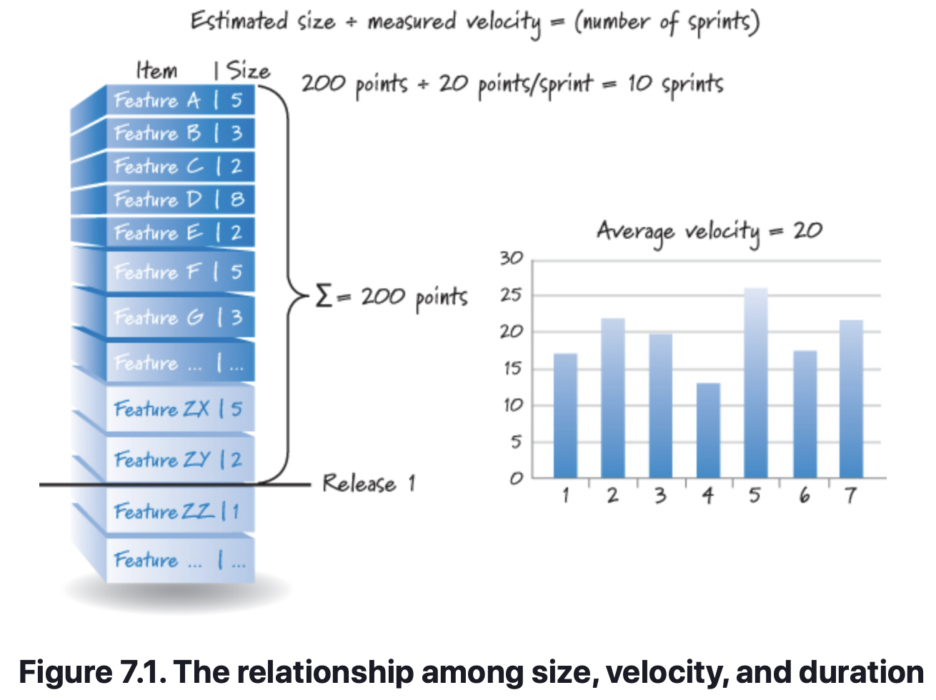
Estimation & Velocity - Overview
Given the product backlog in Figure 7.1, how much time do we need to create the features in Release 1?
To answer that question, we must first gauge the size of Release 1. We can do this by adding the individual size estimates for each PBI targeted for Release 1. (In our example, the sum of the PBI estimates is 200 points.)
Once we know the approximate size of the release, we turn our attention to the team’s velocity, how much work the team typically gets done each sprint.
At the end of each sprint, we simply add the size estimates of every item that was completed during the sprint; if an item isn’t done, it doesn’t count toward velocity. The sum of the sizes of all the completed product backlog items in a sprint is the team’s velocity for that sprint. The graph in Figure 7.1 shows the team’s velocity data for the prior seven sprints.

Slide 6
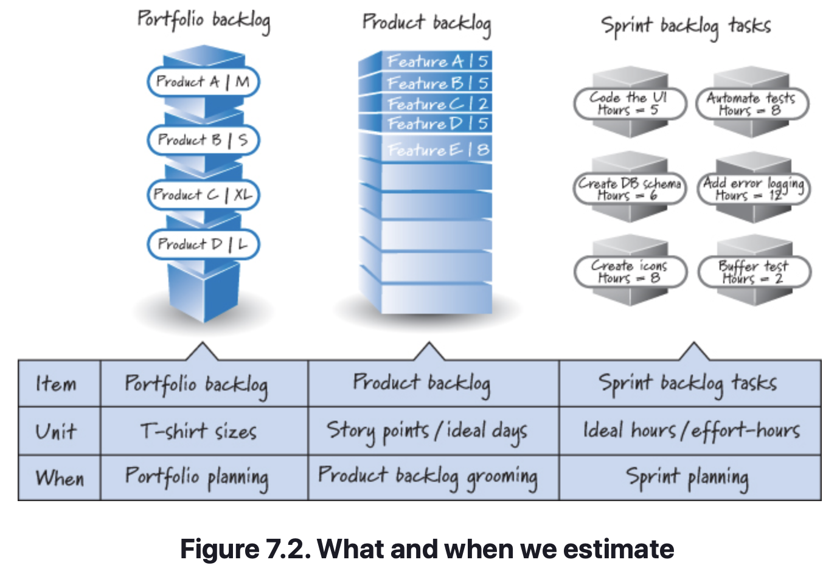
Estimation & Velocity – What & When We Estimate
In Figure 7.1 story points were used to express the PBI estimates for calculating the release duration.
Throughout the development life of a product, however, we need to estimate at varying levels of granularity and, thus, will use different units to do so (see Figure 7.2).
Most organizations make estimates for planning purposes at three different levels of detail. These estimates manifest themselves in the portfolio backlog, product backlog, and sprint backlog. Let’s briefly examine each.

Slide 7
Estimation & Velocity – What & When We Estimate
Portfolio Backlog Item Estimates
Although the portfolio backlog is not formally a part of Scrum, many organizations maintain one that contains a prioritized list of all of the products (or projects) that need to be built.
To properly prioritize a portfolio backlog item we need to know the approximate cost of each item.
Known level of detail for these items is low.
To estimate portfolio backlog items, many organizations choose to use rough, relative size estimates like T-shirt sizes (such as small, medium, large, extra-large, and so on).

Slide 8
Estimation & Velocity – What & When We Estimate
Product Backlog Estimates
Once a product or project is approved and we start adding more detail to its product backlog items, however, we need to estimate differently.
When PBIs have risen in priority and been groomed to include more detail, most teams prefer to put numeric size estimates on them, using either story points or ideal days.
Estimating PBIs is part of the overall product backlog grooming activity.
Typically, PBI estimation occurs in “estimation meetings,” the first of which likely coincides with initial release planning, but could be called by the PO at any time.

Slide 9
Estimation & Velocity – What & When We Estimate
Task Estimates
At the most detailed level we have the tasks that reside in the sprint backlog. Most teams choose to size their tasks during sprint planning so that they can acquire confidence that the commitments they are considering are reasonable.
Tasks are sized in ideal hours (also referred to as effort-hours, man-hours, or person-hours). In Figure 7.2, the team estimates that the UI task will take five effort-hours to complete.
That doesn’t mean it will take five elapsed hours. It might take one person a couple of days to code the UI, or it could take a couple of people working together less than a day.
Notes:
Discuss effort vs. duration.

Slide 10
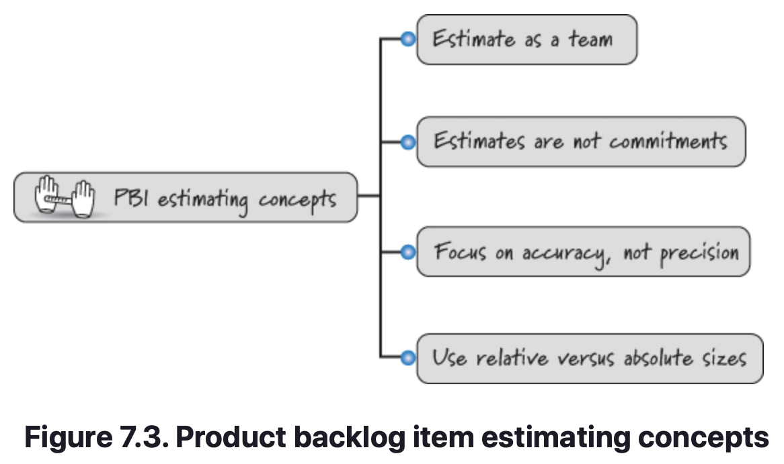
Estimation & Velocity – PBI Estimation Concepts
PBI Estimation Concepts
Though all three levels of detail are important, the remainder of this chapter focuses on product-backlog-level estimation. There are several important concepts that Scrum teams use when estimating PBIs (see Figure 7.3).

Slide 11
Estimation & Velocity – PBI Estimation Concepts
Estimate as a Team
  The people who will do the work collectively provide the estimates, this means the development team. The product owner and ScrumMaster don’t provide estimates, rather they act as facilitators in the estimation process.
Estimates are not Commitments
  The desire is to get a rough order of magnitude and not require precision.
Accuracy vs. Precision
  Our estimates should be accurate without being overly precise.
Relative Size Estimation
  We should estimate PBIs using relative sizes, not absolute sizes. We compare items to determine how large an item is relative to the others.

Slide 12
Estimation & Velocity – PBI Estimation Units
Although there is no standard unit for PBI size estimates, by far the two most common units are story points and ideal days. There isn’t a right or wrong choice when deciding between these two. The majority of organizations use story points.
Story Points
  Story points measure the bigness or magnitude of a PBI. We expect story points to be influenced by several factors, such as complexity and physical size. Something doesn’t have to be physically large to be big.
  Story points combine factors like complexity and physical size into one relative size measure. The goal is to be able to compare stories to each other.
Ideal Days
  An alternative approach for estimating PBIs is to use ideal days. Ideal days are a familiar unit—they represent the number of effort-days or person-days needed to complete a story.
Notes:
Ideal time is not the same thing as elapsed time. Ideally the American football game has four quarters that are each 15 minutes long (so the game is played in one ideal hour). However, it takes more like three to three and a half hours to actually play the game.

Slide 13
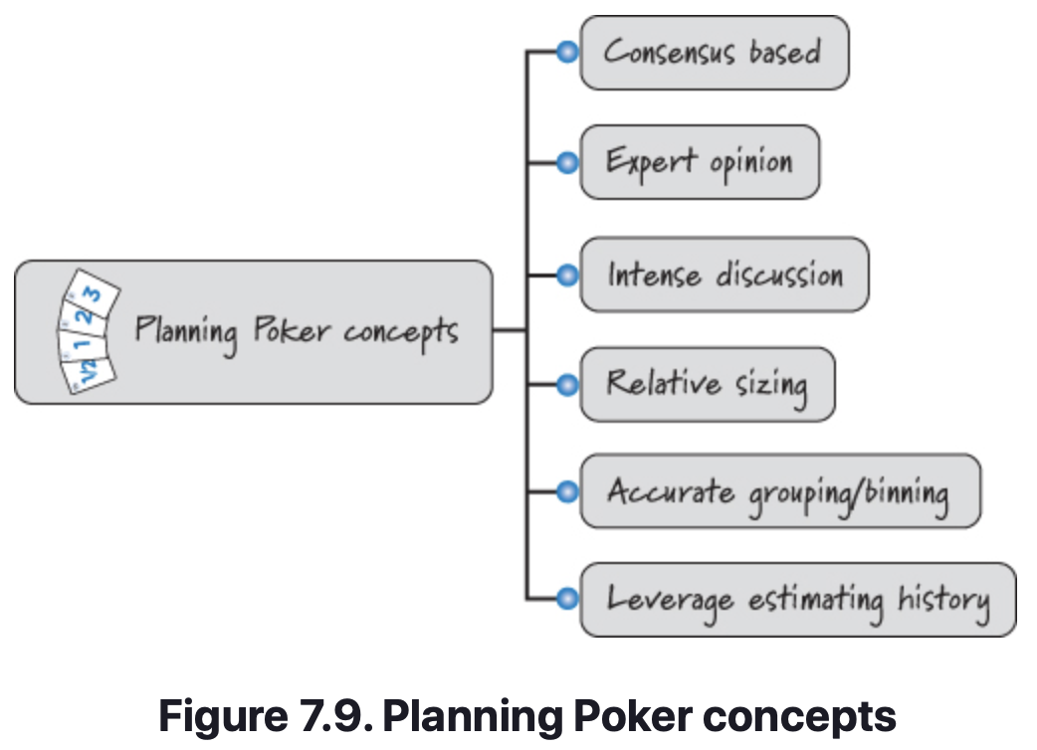
Estimation & Velocity – Planning Poker
Planning Poker is a technique for sizing PBIs that was first described by James Grenning (Grenning 2002) and then popularized by Mike Cohn (Cohn 2006). Planning Poker is based on a few important concepts (see Figure 7.9).
Planning Poker is a consensus-based technique for estimating effort. Knowledgeable people (the experts) slated to work on a PBI engage in an intense discussion to expose assumptions, acquire a shared understanding, and size the PBI. Planning Poker yields relative size estimates by accurately grouping or binning together items of similar size.

Slide 14
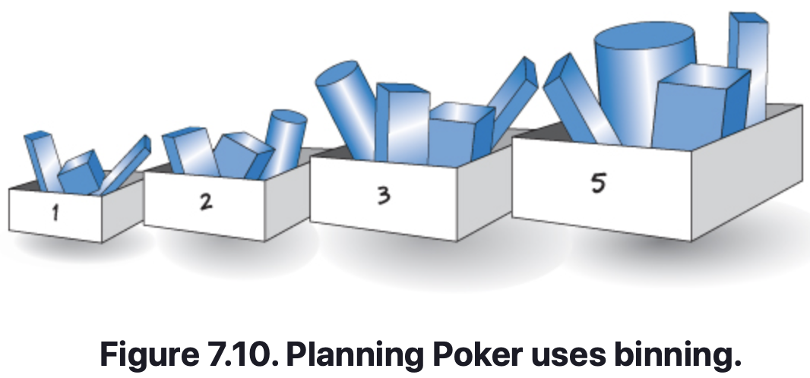
Estimation & Velocity – Planning Poker
To perform Planning Poker, the team must decide which scale or sequence of numbers it will use for assigning estimates.
Goal is to be accurate and not overly precise, we prefer to not use all of the numbers.
Instead, we favor a scale of sizes with more numbers at the small end of the range and fewer, more widely spaced numbers at the large end of the range.
The most frequently used scale is the one proposed by Mike Cohn, based in part on a modified Fibonacci sequence: 1, 2, 3, 5, 8, 13, 20, 40, and 100. An alternative scale that some teams use is based on powers of 2: 1, 2, 4, 8, 16, 32, . . . .
When using this type of scale, we group or bin together like-size PBIs and assign them the same number on the scale (see Figure 7.10).

Slide 15
Estimation & Velocity – Planning Poker
YouTube Video: Estimate Backlog using Planning Poker
https://youtu.be/UJ-NnDficnE

Slide 16
Estimation & Velocity – Velocity
Velocity is the amount of work completed each sprint. It is measured by adding the sizes of the PBIs that are completed by the end of the sprint. A PBI is either done or it’s not done.
Velocity measures output (the size of what was delivered), not outcome (the value of what was delivered). We assume that if the product owner has agreed that the team should work on a PBI, it must have some value to him. However, completing a PBI of size 8 doesn’t necessarily deliver more business value than completing a PBI of size 3.
For release-level planning, velocity is used to calculate the number of sprints necessary to complete the release.
Additionally, at sprint planning, a team’s velocity is used as one input to help determine its capacity to commit to work during the upcoming sprint.

Slide 17
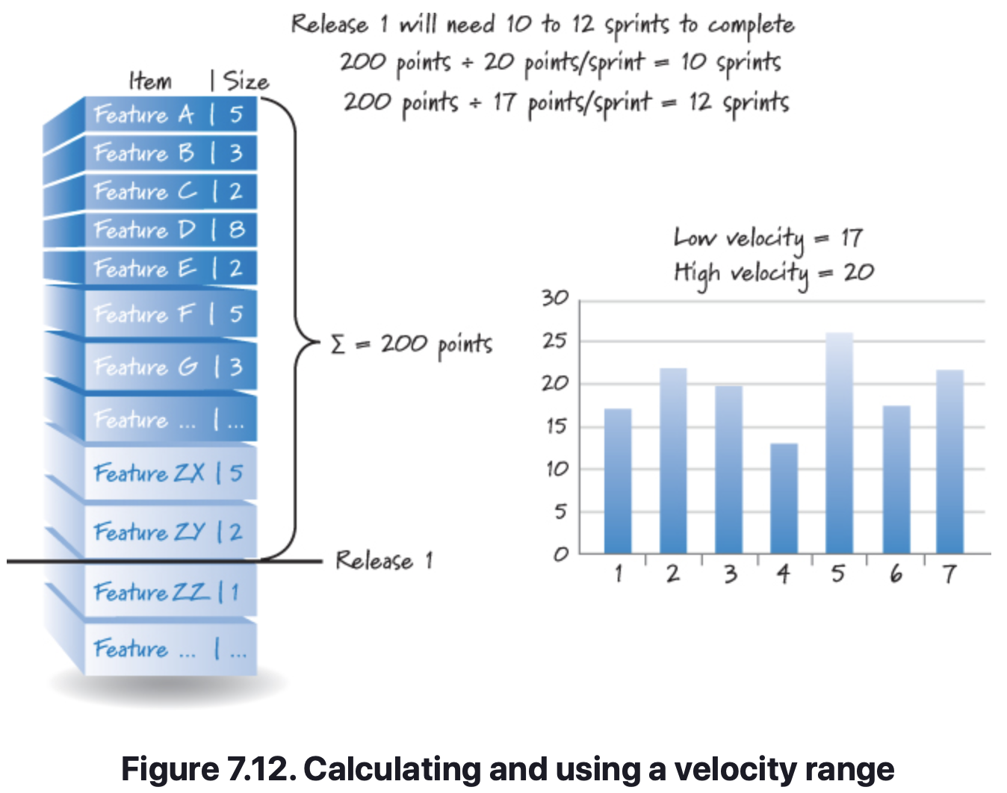
Estimation & Velocity – Calculate a Velocity Range
For planning purposes, velocity is most useful when expressed as a range, such as “The team is typically able to complete between 25 and 30 points each sprint.” Using a range allows us to be accurate without being overly precise.
With a velocity range we can more accurately provide answers to questions like “When will we be done?” “How many items can we complete?” or “How much will all this cost?” Because most of these questions get asked early on in a product development effort, when we have the least information about the product, it’s impossible to give a very precise answer.
By using a range, we can communicate our uncertainty (see Figure 7.12).

Slide 18
Estimation & Velocity – Calculate a Velocity Range
Forecasting Velocity
Historical velocity data can help predict future velocity.
However, new teams will be formed that haven’t worked together and therefore have no historical data. How do we handle this? We’ll have to forecast it.
One common way to forecast a team’s velocity is to have the team perform sprint planning to determine what PBIs it could commit to delivering during a single sprint.
If the commitment seems reasonable, we would simply add the sizes of the committed PBIs and use that as the team’s forecasted velocity.
Affecting Velocity
Should a team’s velocity should constantly increase over time?
It is likely that a team, which is proactively attempting to improve itself will see incremental improvements up to a point.
However, this expectation should be set with caution, as there are many variables that could adversely impact velocity.

Slide 19
Estimation & Velocity – Calculate a Velocity Range
Misusing Velocity
Velocity is used as a planning tool and as a team diagnostic metric. It should not be used as a performance metric in an attempt to judge team productivity. When misused in this way, velocity can motivate wasteful and dangerous behavior.
For example, say I have decided to give the largest bonus to the team that has the highest velocity. Superficially this idea might seem sensible; the team with the highest velocity must be getting the most work done each sprint, right? So, why not reward that behavior?
Comparing number of PBI’s between different teams/products is not likely to be equally weighted.
This will likely cause teams to modify point values in favor of completing more PBI’s, which is referred to as point inflation.
Even worse than point inflation is when teams cut corners to get more “done” in an effort to achieve higher, more desirable velocities.

Slide 20
Estimation & Velocity – Closing
We discussed how sizes are estimated, velocity is measured, and duration is calculated.
Illustrated how estimation applies to portfolio-level items, product backlog items, and tasks.
Focused specifically on PBIs by discussing important concepts related to PBI estimation, including story points and ideal days.
Described a technique known as Planning Poker that is commonly used to estimate PBIs.
Moved from estimation to a discussion of velocity and how it should be used.
Reinforced that velocity is most helpful when expressed as a range instead of a single number. Briefly mentioned ways that we might forecast the velocity for a new team.
Concluded by discussing how velocity can be and frequently is misused.

Slide 21
Technical Debt
Chapter 8

Slide 22
Technical Debt – Overview
Overview
Ward Cunningham was the first to write about the concept of technical debt (Cunningham 1992). He defined it as follows:
Shipping first time code is like going into debt. A little debt speeds development so long as it is paid back promptly with a rewrite. . . . The danger occurs when the debt is not repaid. Every minute spent on not-quite-right code counts as interest on that debt. Entire engineering organizations can be brought to a stand-still under the debt load of an unconsolidated implementation. . . .
Cunningham used the technical debt metaphor to explain to his business team why creating software fast to get feedback was a good thing.
In doing so, however, he emphasized two key points:
  The team and organization need to be vigilant about repayment of the debt as their understanding of the business domain improves, and the design and implementation of the system need to evolve to better embrace that understanding.

Slide 23
Technical Debt – Overview
Overview – Naïve Technical Debt
Cunningham didn’t intend for technical debt to refer to team member or business immaturity or process deficiencies that lead to sloppy design, poor engineering practices, and a lack of testing.
This kind of debt can be eliminated through proper training, a good understanding of how to apply technical practices, and sound business decision making.
Because of the irresponsible and frequently accidental nature of how this type of debt is generated, I refer to it as naive technical debt. It is also known by other names: reckless debt (Fowler 2009), unintentional debt (McConnell 2007), and mess (Martin 2008).

Slide 24
Technical Debt – Overview
Overview – Unavoidable Technical Debt
In addition, there is unavoidable technical debt, which is usually unpredictable and unpreventable.
For example, our understanding of what makes for a good design emerges from doing the design work and building user-valuable features on it. We can’t perfectly predict up front how our product and its design will need to evolve over time.
So, design and implementation decisions we made early on might need to change as we close important learning loops and acquire validated learning.
The changes required in the affected areas are unavoidable technical debt.

Slide 25
Technical Debt – Overview
Overview – Strategic Technical Debt
The final type of technical debt is strategic technical debt.
This kind of debt is a tool that can be used to help organizations better quantify and leverage the economics of important, often time-sensitive, decisions.
For example, an organization might deliberately make a strategic decision to take shortcuts during product development to achieve an important short-term goal, such as getting a time-sensitive product into the marketplace.
Also, for a capital-strapped organization that is at risk of running out of money before it can complete its product, getting a product with technical debt to market at a reduced initial development cost and then generating revenue to self-fund ongoing development may be the only way for the organization to avoid death before deployment.

Slide 26
Technical Debt – Overview
Overview – Organizational Interpretation of Technical Debt
Regardless of how the debt was accrued, technical debt is a powerful metaphor because it raises awareness of and provides visibility into an important issue.
The metaphor resonates well with business people who tend to be well versed in financial debt. When they hear technical debt, they can quickly appreciate the insightful parallels, the most important being that just like financial debt, technical debt requires interest payments, which come in the form of extra future development effort.
We can choose to continue paying the interest (by working around the problems), or we can pay down the debt principal (for example, by refactoring the code to make it cleaner and easier to modify).

Slide 27
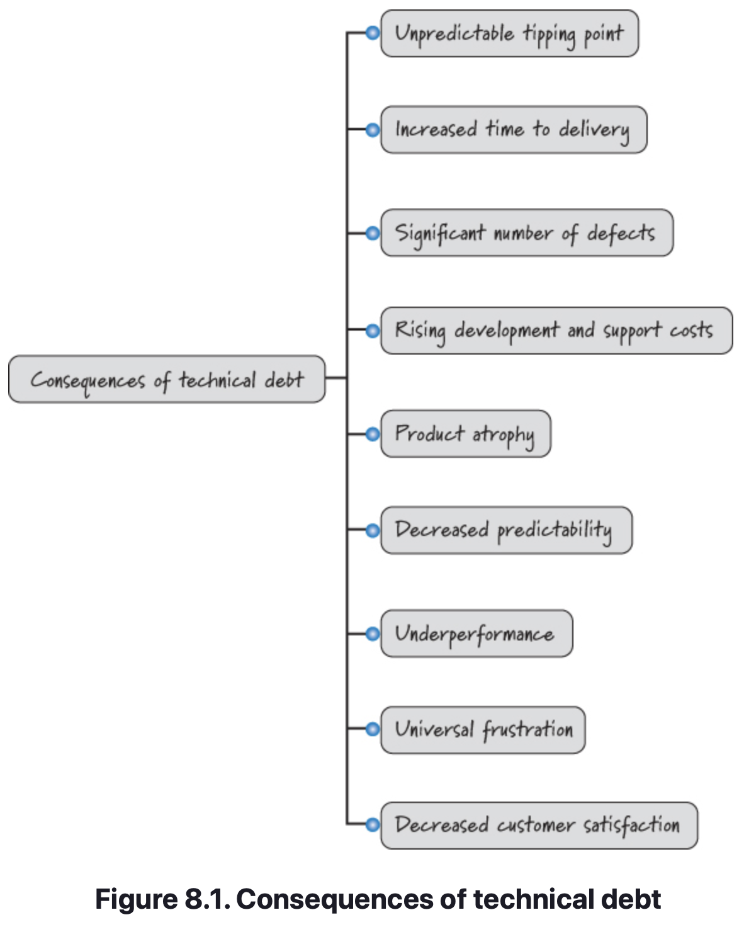
Technical Debt – Consequences
As the level of technical debt rises, so does the severity of the consequences. Let’s discuss a few of the more notable consequences of high levels of technical debt (summarized in Figure 8.1).

Slide 28
Technical Debt – Consequences
Unpredictable Tipping Point
An important attribute of technical debt is that it grows in an unpredictable, nonlinear fashion and if not consciously managed can become chaotic.
Increased Time to Delivery
Taking on technical debt means taking a loan today against the time required to do future work. The greater the debt today, the slower the velocity tomorrow.
Significant Number of Defects
Products with significant technical debt become more complex, making it harder to do things correctly. The compounding defects can cause critical product failures to happen with alarming frequency.

Slide 29
Technical Debt – Consequences
Rising Development & Support Costs
As technical debt increases, development and support costs start rising. What used to be simple and cheap to do is now complicated and expensive.
Product Atrophy
As we stop adding new features or fixing defects that could rejuvenate our aging product, the product becomes less and less appealing to current and potential customers. As a result, the product starts to atrophy and simply ceases to be a viable option for most customers.
Decreased Predictability
For a product with high levels of technical debt, making any sort of prediction is nearly impossible. For example, estimates become bad estimates even for the most experienced team members.

Slide 30
Technical Debt – Consequences
Underperformance
For a product with high levels of technical debt, making any sort of prediction is nearly impossible. For example, estimates become bad estimates even for the most experienced team members.
Universal Frustration
The unfortunate human consequence of high technical debt is that everyone in the value chain becomes frustrated. The accumulation of all of those small but annoying shortcuts makes work on the product painful.
Decreased Customer Satisfaction
Customer satisfaction will decrease as customer frustration increases. So the extent of the damage caused by technical debt is not just isolated to the development team or even to the development organization as a whole.

Slide 31
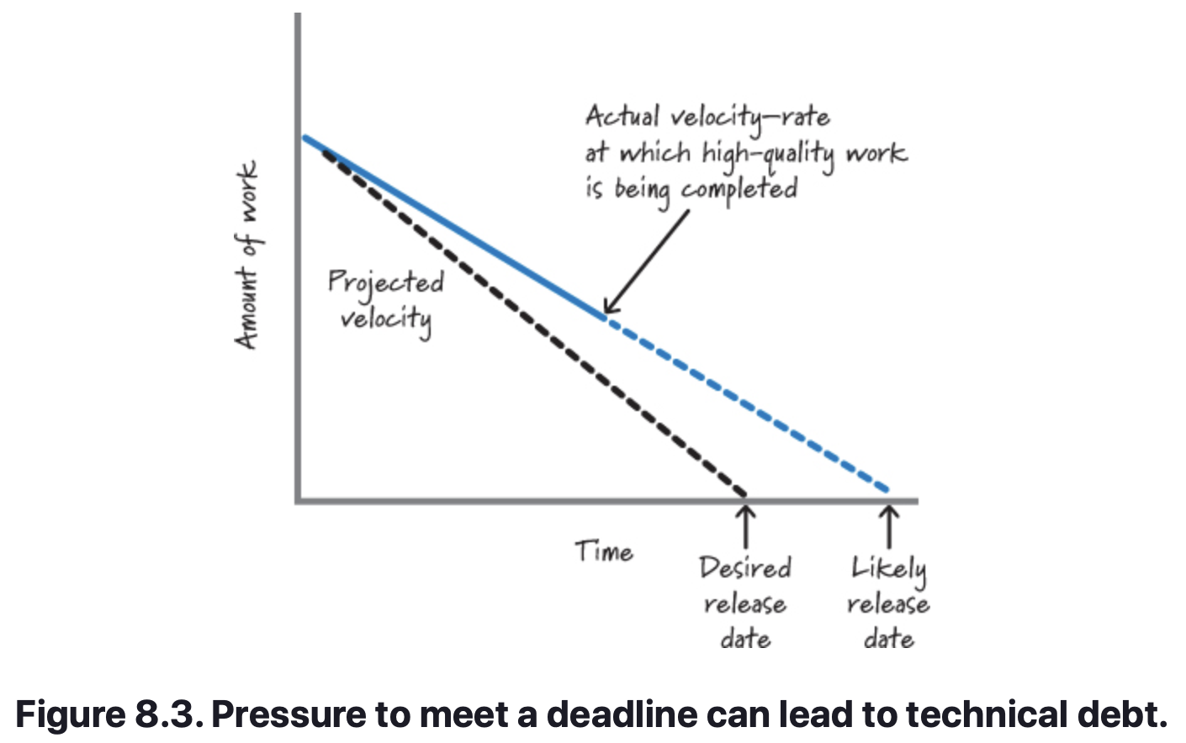
Technical Debt – Causes of Technical Debt
Pressure to Meet a Deadline
Both strategic and naive technical debt, however, are often driven by business pressure to meet an important looming deadline (see Figure 8.3, based on Mar 2006).
The vertical dimension represents the amount of work we want to accomplish by a desired release date (shown on the horizontal dimension). The line between the amount of work and the desired release date represents the constant projected velocity at which work must be completed to meet the desired release date.
However, as we start doing the work, the actual velocity needed to produce high-quality results is slower than the projected velocity. If we continue producing results at the actual velocity, we’ll miss the desired release date and finish instead on the likely release date.

Slide 32
Technical Debt – Causes of Technical Debt
Attempting to Falsely Accelerate Velocity
Do we want to cut scope to meet the desired release date, or do we wish to add more time to the schedule to accommodate a delivery on the likely release date? Unfortunately, in many circumstances the business rejects both of those options and decrees that the team must meet the desired release date with all of the features.
Myth: Less Testing Can Accelerate Velocity
A prevalent myth is that testing is additional overhead, and by reducing it, we can accelerate velocity. The reality is that reducing testing will both increase debt and cause us to go slower, because problems will go undetected until later when it is much more time-consuming to fix them.
Debt Builds on Debt (e.g. compounds)
Future technical debt builds quickly on top of existing technical debt. And, as the technical debt begins to build, economically harmful consequences start to appear.

Slide 33
Technical Debt – Managing the Accrual of Technical Debt
A critical dimension of managing technical debt is to manage the debt accrual process. As discussed earlier, there is only so much technical debt we can take on before we reach a critical mass. By analogy, continuously accruing technical debt is equivalent to continuously borrowing money against our house. At some point we just need to stop and say, “No more!” because the consequences become too severe.
Use Good Technical Practices
Using good technical practices is an excellent starting point and avoids the accrual of naïve technical debt. Although Scrum does not formally define technical practices, successful Scrum teams employ practices such as simple design, test-driven development, continuous integration, automated testing, refactoring, etc.

Slide 34
Technical Debt – Managing the Accrual of Technical Debt
Use Good Technical Practices
Using good technical practices is an excellent starting point and avoids the accrual of naïve technical debt. Although Scrum does not formally define technical practices, successful Scrum teams employ practices such as simple design, test-driven development, continuous integration, automated testing, refactoring, etc.
Use a Strong Definition of Done
Work that we should have performed when a feature was built, but ended up deferring until a later time, is an important cause of technical debt. The more technically encompassing we make our definition-of-done checklist, the less likely we are to accrue technical debt.

Slide 35
Technical Debt – Managing the Accrual of Technical Debt
Properly Understand Technical Debt Economics
To use technical debt strategically and advantageously, we must properly understand how it affects the economics of our decisions.
Many organizations don’t understand the implications of technical debt well enough to correctly quantify the economics of taking it on.
Sometimes, taking on technical debt in order to meet a critical timeline may be required to keep the product and the company viable.
Understand that the technical debt will eventually need to be paid back, but taking a “loan” to be repaid at a future date may be required.
Often times, the decision isn’t so clear-cut. The choice of whether or not to assume the debt usually requires detailed analysis to discern which is the better option.
When deciding, err on the side of not taking on the debt, as the debt often ends up being more burdensome than originally estimated.

Slide 36
Technical Debt – Making Technical Debt Visible
One of the principal benefits of the technical debt metaphor is that it enables the development team and the business people to have a necessary conversation using a shared context. To have that conversation, both need visibility into the product’s technical debt position in a way that each can understand.
Make Technical Debt Visible at the Business and Technical Levels
It is essential to provide business and technical people with visibility into the product’s technical debt position. One idea is to have it be a PBI in the product backlog. Another might be to include it within the defect tracking system.

Slide 37
Technical Debt – Servicing the Technical Debt
The last activity in managing technical debt is to service or repay the debt. When discussing debt servicing, it may be helpful to use the following status categories:
Happened-upon technical debt—debt that the development team was unaware existed until it was exposed during the normal course of performing work on the product. For example, the team is adding a new feature to the product and in doing so it realizes that a work-around had been built into the code years before by someone who has long since departed.
Known technical debt—debt that is known to the development team and has been made visible using one of the previously discussed approaches.
Targeted technical debt—debt that is known and has been targeted for servicing by the development team.

Slide 38
Technical Debt – Servicing the Technical Debt
Consider applying the following algorithm when servicing technical debt:
Determine if the known technical debt should be serviced (as I will discuss, not all debt should be serviced). If it should be serviced, go to step 2.
If you are in the code doing work and you discover happened-upon technical debt, clean it up. If the amount of happened-upon technical debt exceeds some reasonable threshold, clean it up until you reach that threshold. Then classify the nonserviced, happened-upon technical debt as known technical debt (for example, by creating entries in the technical debt backlog).
Every sprint, consider designating some amount of known technical debt as targeted technical debt to be serviced during the sprint. Favor servicing known technical debt with a high interest rate that is aligned with customer-valuable work.

Slide 39
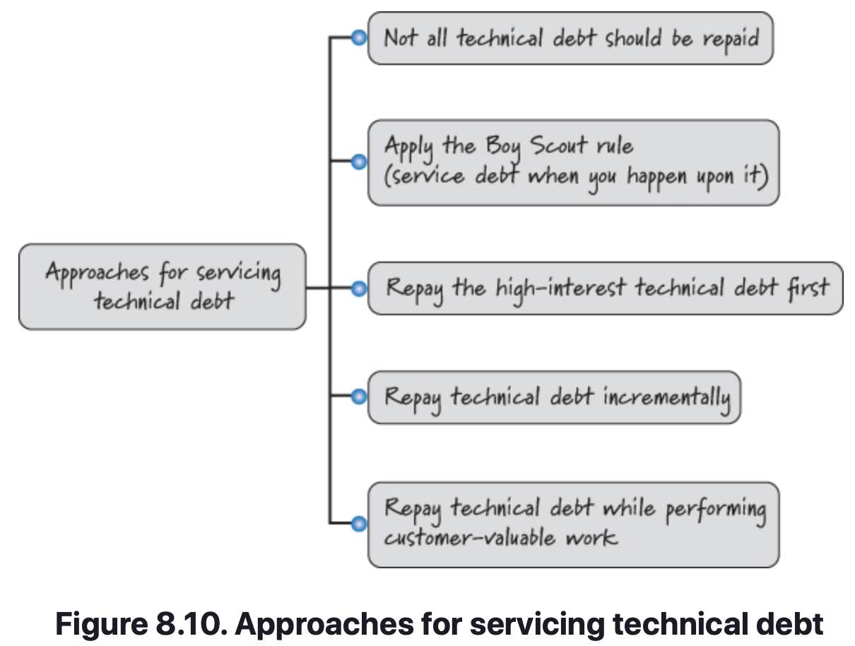
Technical Debt – Servicing the Technical Debt
The approaches shown in Figure 8.10 expand on this algorithm for servicing technical debt.

Slide 40
Technical Debt – Servicing the Technical Debt
Not All Technical Debt Should be Repaid
Product nearing end of life.
Throwaway Prototype.
Product Built for a Short Life (think: Viral Products).
Apply the Boy Scout Rule (Service Debt When You Happen Upon It)
There is a Boy Scout rule: “Always leave the campground cleaner than you found it.” If you find a mess on the ground, you clean it up regardless of who might have made the mess. You intentionally improve the environment for the next group of campers. Following this rule, we try to always make our product design and implementation a little better, not a little worse, every time we touch it.

Slide 41
Technical Debt – Servicing the Technical Debt
Repay Technical Debt Incrementally
In some products the accrued technical debt level might be quite high. Teams working on such products frequently end up making large balloon payments as a means of servicing their debt load. They would be far better off if they made many, timely, incremental payments against known technical debt instead of large late payments. Smaller, more frequent payments are akin to making monthly payments against a home mortgage.
Repay the High-Interest Technical Debt First
Not all types of technical debt are of equal importance. An example of an important form of debt is a frequently modified module that a lot of other code depends on and is in real need of refactoring because it’s becoming increasingly difficult to change.

Slide 42
Technical Debt – Servicing the Technical Debt
Repay Technical Debt While Performing Customer-Valuable Work
Let’s assume that for every customer-valuable product backlog item we work on, we also do several things.
First, we commit to doing high-quality work so that we don’t add new naive technical debt when we create the customer feature.
Second, we apply the Boy Scout rule and clean up whatever happened-upon technical debt that we reasonably can when we are in the area doing work related to our feature.
And third (the core attribute of this approach), we specifically repay targeted technical debt in the area in which we will be working.

Slide 43
Technical Debt – Closing
Discussed the concept of technical debt, which accrues when we take shortcuts today at tomorrow’s expense.
Distinguished among naive, unavoidable, and strategic technical debt.
Explained the consequences of poorly managed levels of technical debt.
Discussed the three activities associated with controlling technical debt: managing the accrual of technical debt, making technical debt visible, and servicing technical debt.

Slide 44
Sprints
Sources
Unless otherwise noted, all material in these slides were used from the textbook for this course:
Rubin, Kenneth S., Essential Scrum: A Practical Guide to the Most
Popular Agile Process, 1st Edition. Addison-Wesley Professional; 1st
edition (August 5, 2012). ISBN-13: 978-0137043293.

